Slide 1
Maximización de la Expectativa
Método no supervisado para la estimación de parámetros
León Felipe Dueñas González
Febrero 2025

Slide 2

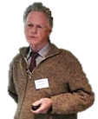
Surgimiento
Quien lo planteo
El algoritmo EM fue descubierto y empleado por distintas personas de forma independiente por varios investigadores hasta que Dempster trajo esas ideas juntas , provo la convergencia y acuño el termino “EM algorithm.”
A.P. Dempster, N.M. Laird, and D.B. Rubin, “Maximum likelihood from incomplete data via the EM algorithm,” J. Royal Statiscal Soc., Ser. R, vol.39, no.1, pp.1-38,1977.
Moon, T. K. (1996). The expectation-maximization algorithm. IEEE Signal processing magazine, 13(6), 47-60.

Slide 3
Algoritmo
¿En qué consiste?
Paso E:
Calculamos la esperanza de la función de verosimilitud
Algoritmo que iterativo para encontrar estimaciones de máxima verosimilitud cuando no se cuentan con los datos suficientes.
Iteramos
Paso M
Se máximisa la función de verosimilitud

Slide 4

Market size
Many of these ranches rely on outdated methods
This presents an opportunity to implement AI-powered livestock counting and monitoring technologies.

Slide 5
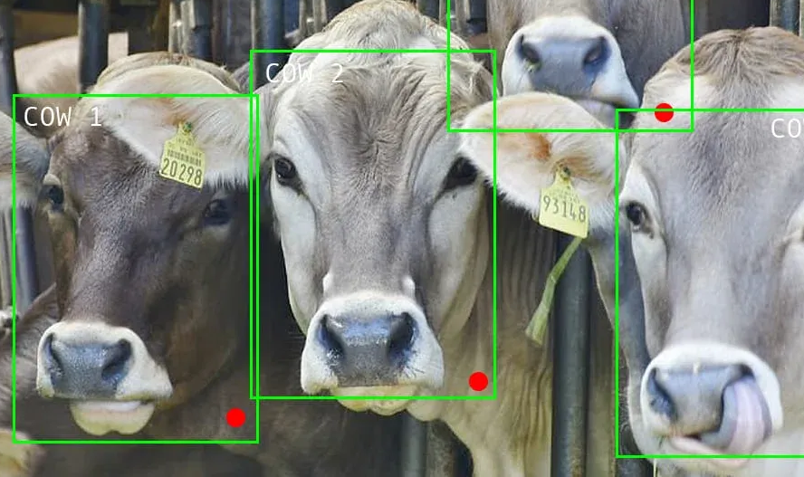
The solution
What alternatives can we offer?
Artificial intelligence gives us the ability to recognize and count animals in real time.

Slide 6
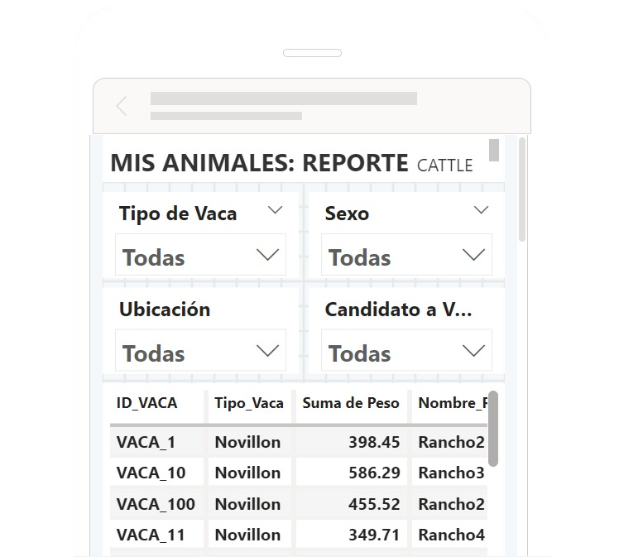
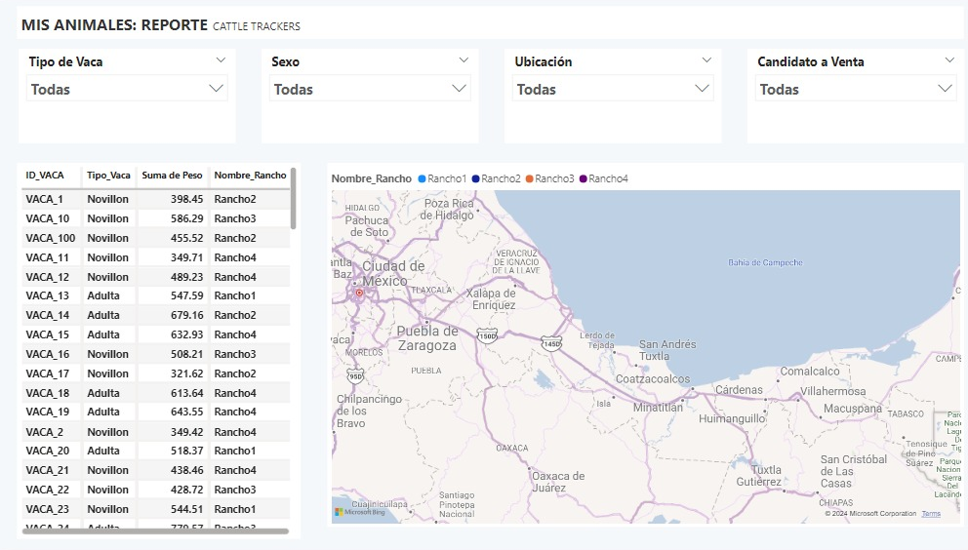
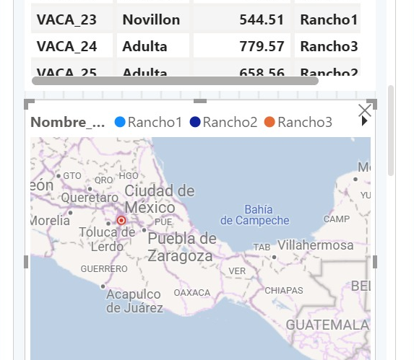
Our product
A technological solution for humans

Slide 7
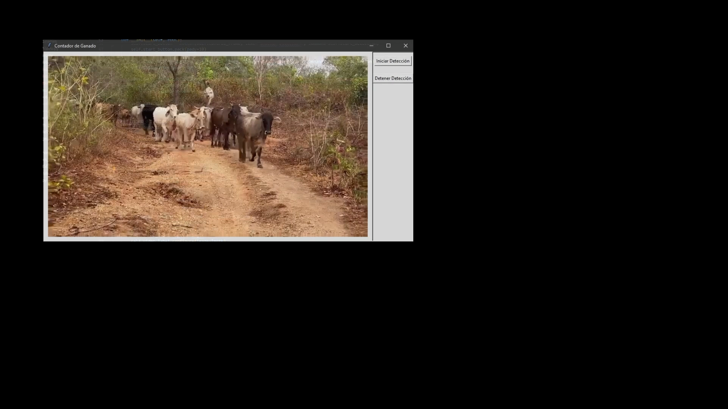
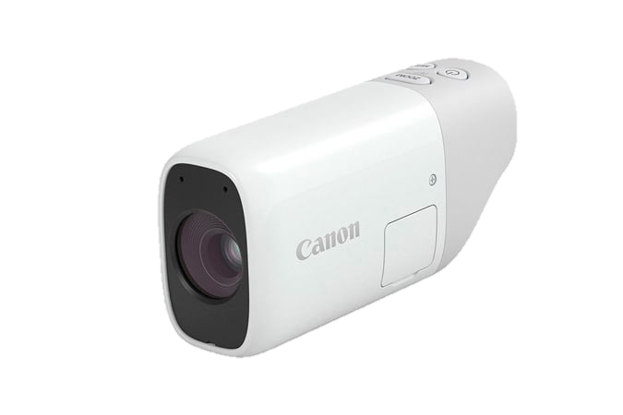
Technological processes
Proof of concept design
Cloud server
installed equipment
Cloud server
Process the videos to generate the count
Video capture
Save video clips
OpenCV
YOLOv4-tiny
SQL database
Power BI
Save information for later reference
Dashboard that is fed from the database

Slide 8
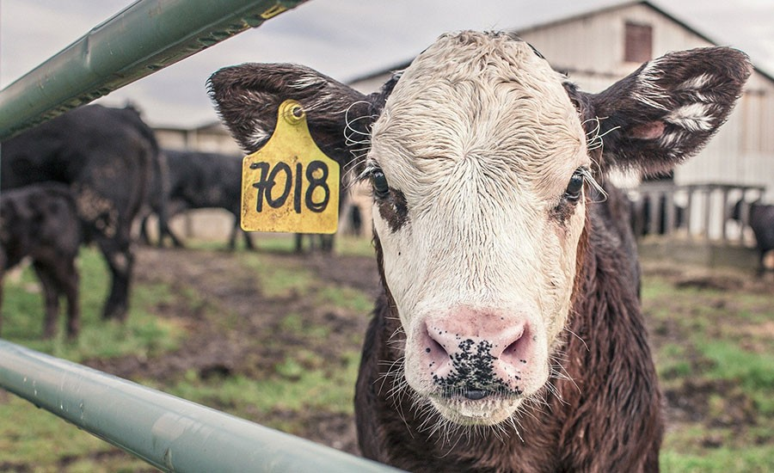
Main competitors
What options do you have on the market?
RFID (Radio Frequency Identification) technology is positioned as the dominant product for livestock registration.
Disadvantages
High Initial Costs: The prices of readers, infrastructure, software and labels can be prohibitive for small farmers.
Data Security: There is a possibility that the data collected may be vulnerable to unauthorized access.
Tag Damage: When they are placed on the ears, they can be lost, damaged, or torn off by the animal itself, which will require frequent replacements.

Slide 9
The cost
What alternatives can we offer?
Artificial intelligence gives us the ability to recognize and count animals in real time.

Slide 10

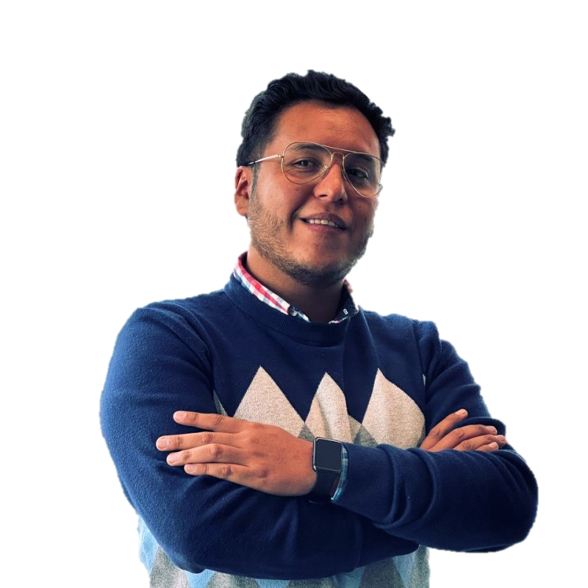



CEO
Rodrigo Moreno
Master in Computing
Physics
CFO
COO
CTO
CDO
Leon Dueñas
Master in computing
Financial Engineering
Actuary
Jorge Rosales
Master in Computing
Systems and Network Engineering
Ramon Santos
Master in Computing
Biomedical Physics
Ulises Aguilar
Master in Computing
Electrical Engineering

Slide 11
Financial model
We need you
At this price level with only 0.002% of the market in 20 months we will achieve equilibrium. Resulting in an IRR of 70% annually.
Basic
Recommended
Premium
-Up to 5 input and output to monitor
-Unlimited updatea a day
-Advanced analytics
-Up to 15 input and output to monitor
-unlimited updatea a day
-Advanced analytics
-Process optimization consulting
-One input and output to monitor
-One update a day
We require 60k of seed capital in exchange for 48% of the company with a simulated IRR of 8% per year
$500 USD
$675 USD
$875 USD

Slide 12
Thank you!

Slide 13
Price model
Van Westendorp
Optimal price range between 612 usd and 725 usd

